Slide 1
Nakuja Internship Week 6 Progress Report
IAN KIBANDI

Slide 2
Tasks completed last week
Propellant casting
Set up raspberry pi zero W
Saved video recording to sd Card
Researched on long range video transmission with pi
Streaming to youtube
Researching on geolocation**

Slide 3
Tasks to complete this week
Continue casting propellant and firing tests.
Work on long range video transmission(compare
Continue working on geolocation with raspberry pi

Slide 4
SAVING VIDEO TO SD CARD
Code on github

Slide 5
Setting up raspberry pi
Raspbian OS
Access via SSH

Slide 6
Long range video transmission
OpenHD FPV
LoRa module

Slide 7
OpenHD FPV
“OpenHD uses off-the-shelf Wi-Fi adapters available for purchase online, however it is not standard Wi-Fi, which is unsuitable for low-latency or very long distance transmission. Instead, Open.HD configures the Wi-Fi adapter in a way that is closer to a simple broadcast, much like analog video transmission hardware you may be using already.
High definition video, 2-way UAV telemetry, audio, and RC control signals can all be sent over a single transmission channel.”(Github)
https://github.com/OpenHD/Open.HD#:~:text=Welcome%20to%20OpenHD!,-OpenHD%20uses%20off&text=HD%20configures%20the%20Wi%2DFi,A%20multi%2Dplatform%20Open.

Slide 8
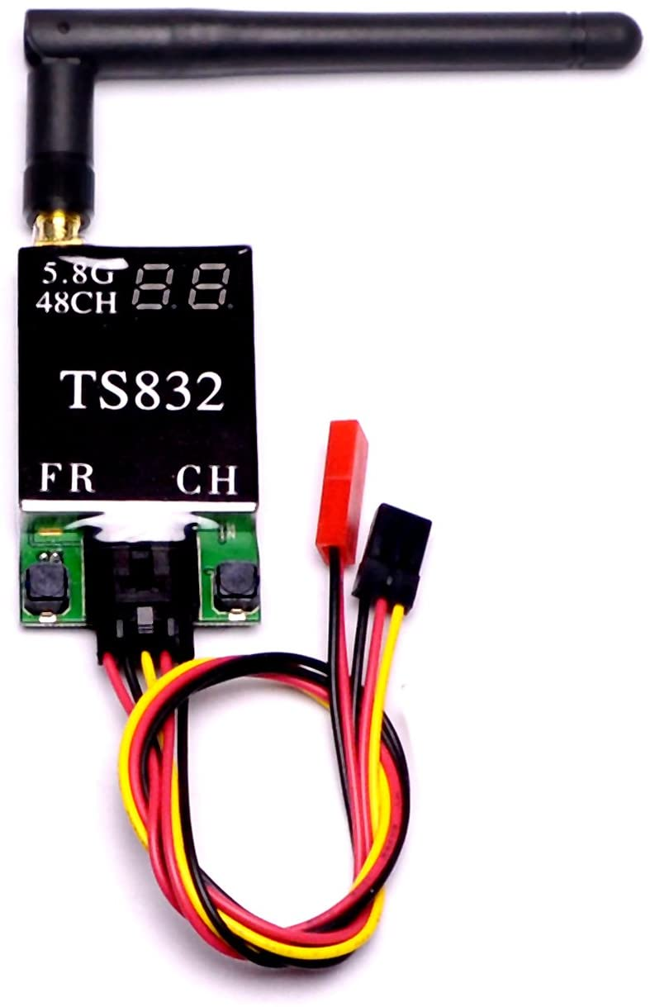

Slide 9
Streaming to youtube
Was able to stream via commandline(github)

Slide 10
Getting GPS from raspberry pi
Requires a GPS module for accurate results

Slide 11
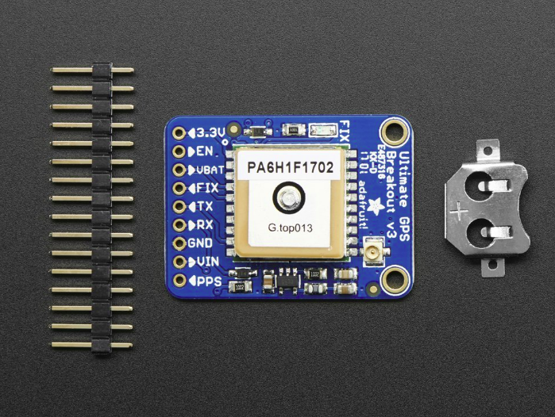

Slide 12
Timeline
Month | Week | Tasks
March | Week1 | Design and fabrication of nozzle
 | Week2 | Design and fabrication of test stand
 | Week3 | Casting propellant
 | Week4 | Testing the model rocket on motor
April | Week1 | Avionics bay development
 | Week2 | Integration and testing with avionics
 | Week3 | Integration and testin with propulsion
 | Week4 | Launch of N-1 rocket

